Slide 1
ELECTRICITY PORTAL
AUTHOR – TAMANNA
EMAIL – TAMANNAS10110@GMAIL.COM
MOB. - 9877553894

Slide 2
PROBLEM STATEMENT
In the modern age of automation and digitalization, suppose the client wants to create a web application for it’s staff with capability to view and edit the connections made/requested by the user. To solve the problem and get an edge over its competitors, the client wants a Multi-Page User Interface to keep track of applied connections and their status.

Slide 3
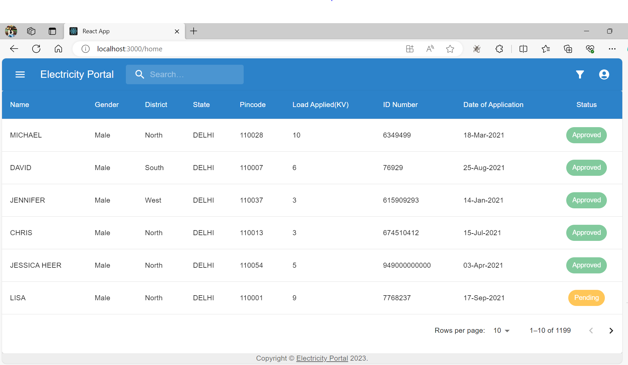
ELECTRICITY PORTAL
MARKET GAP

Slide 4
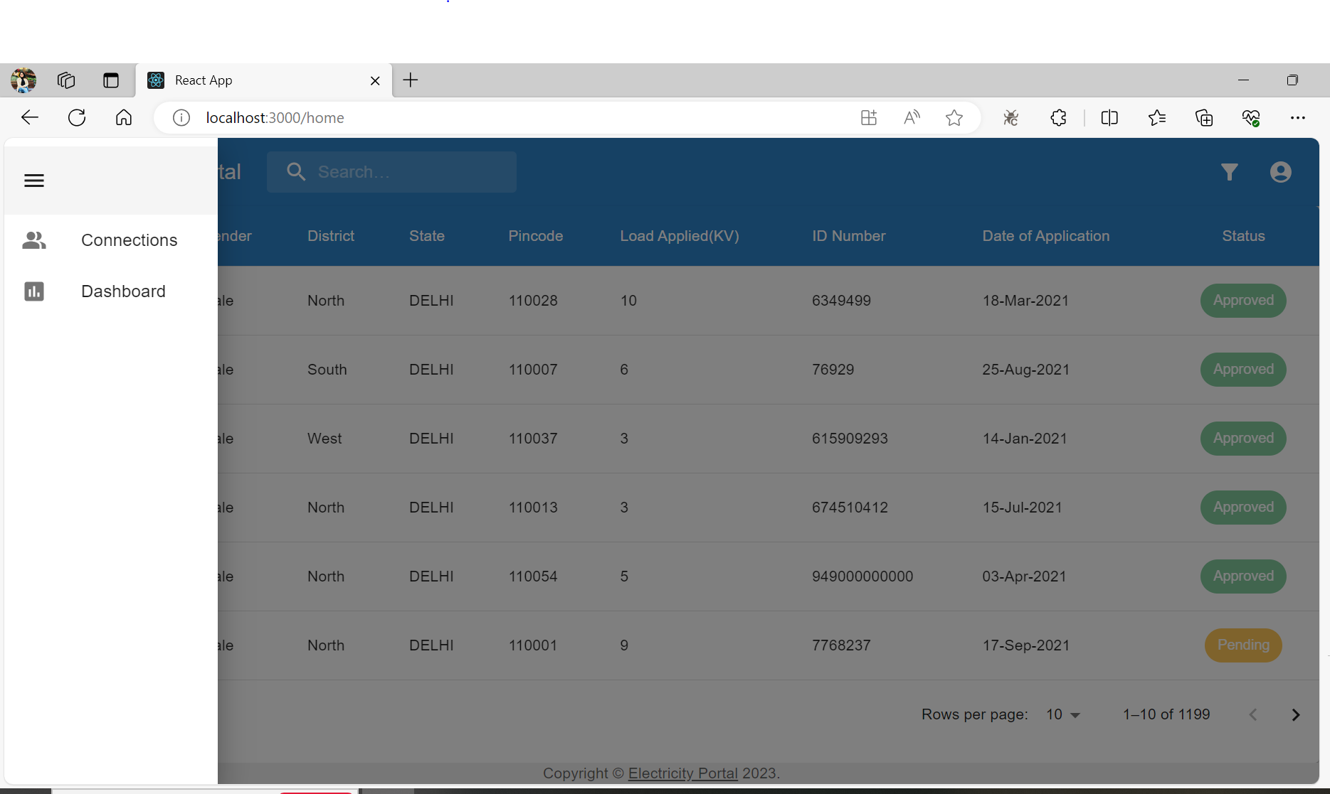
OPTION TO VIEW CONNECTIONS/ DASHOARD
MARKET GAP

Slide 5
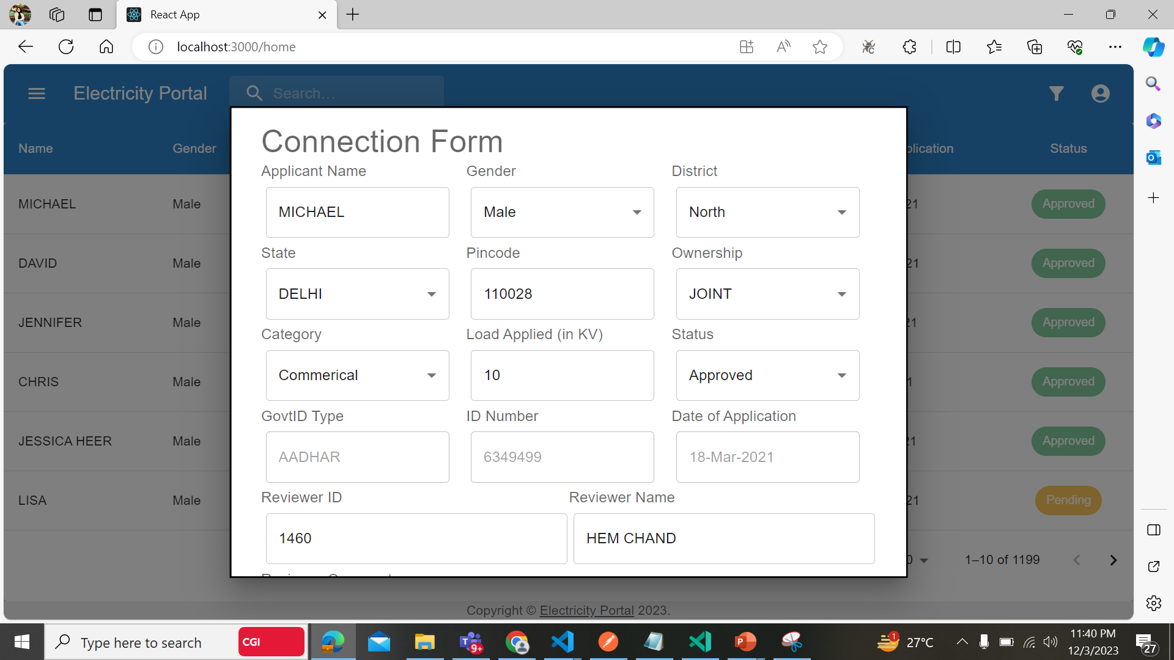
UPDATE CONNECTIONS
MARKET GAP

Slide 6
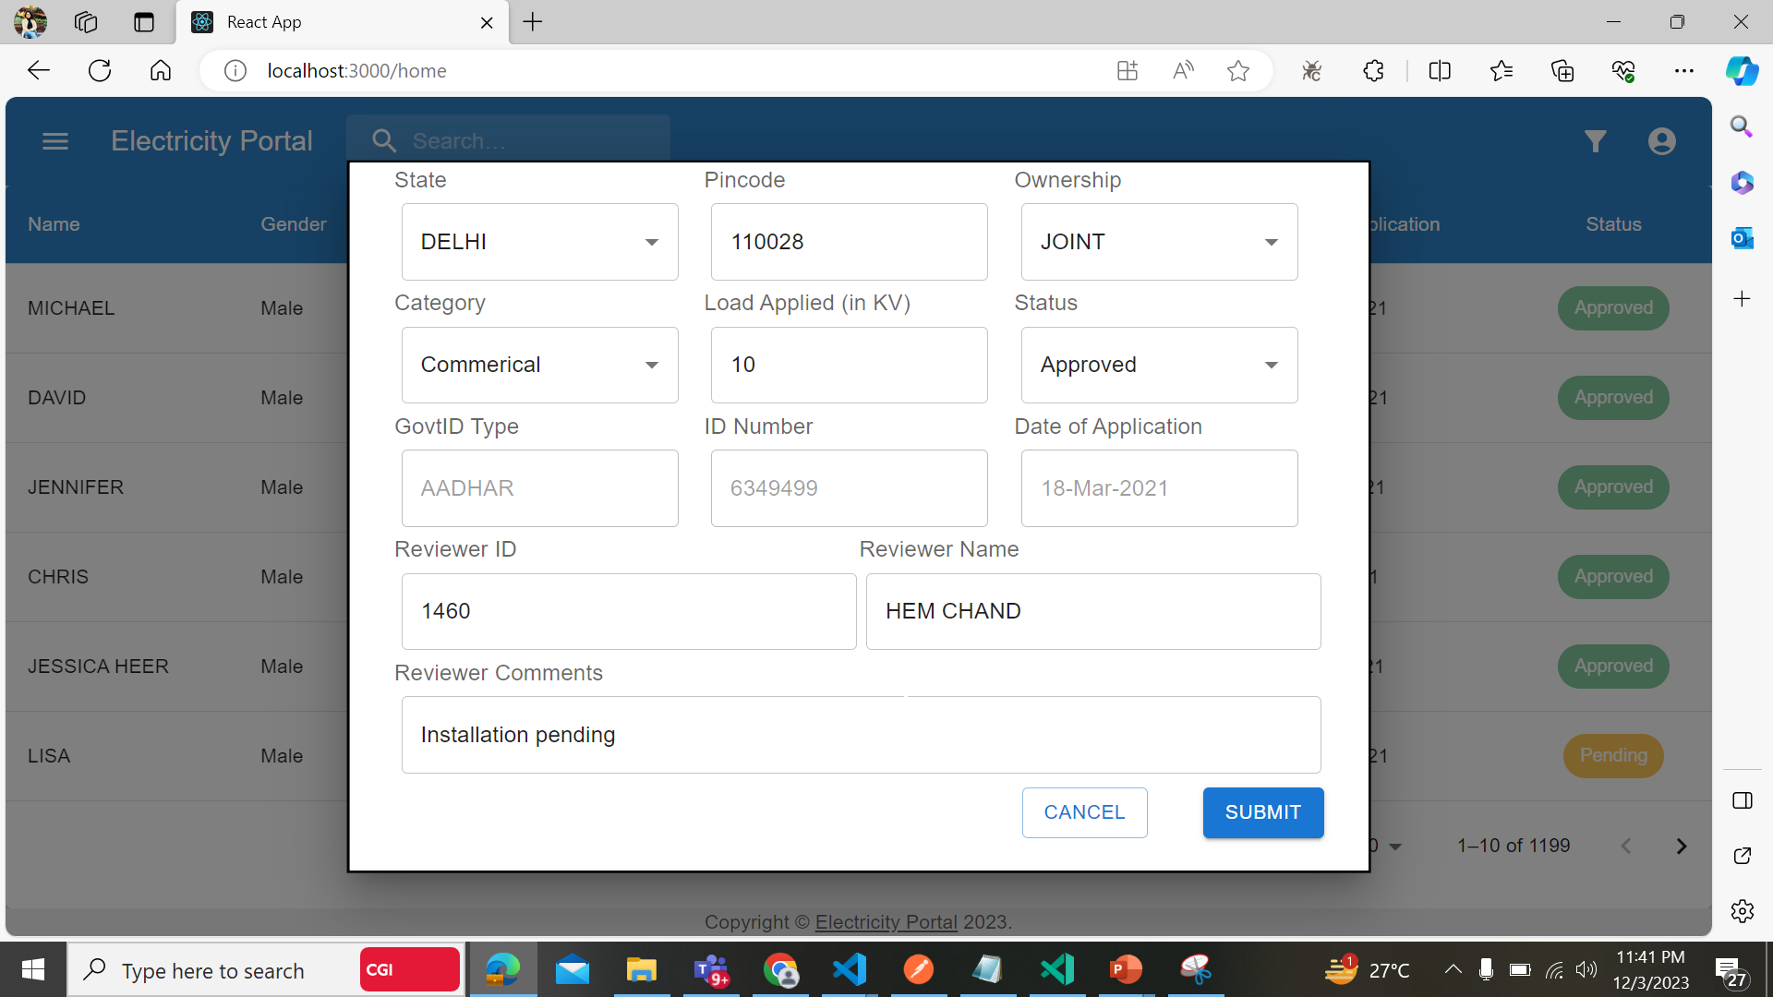
DATA VALIDATIONS DURING THE UPDATE FORM
MARKET GAP

Slide 7
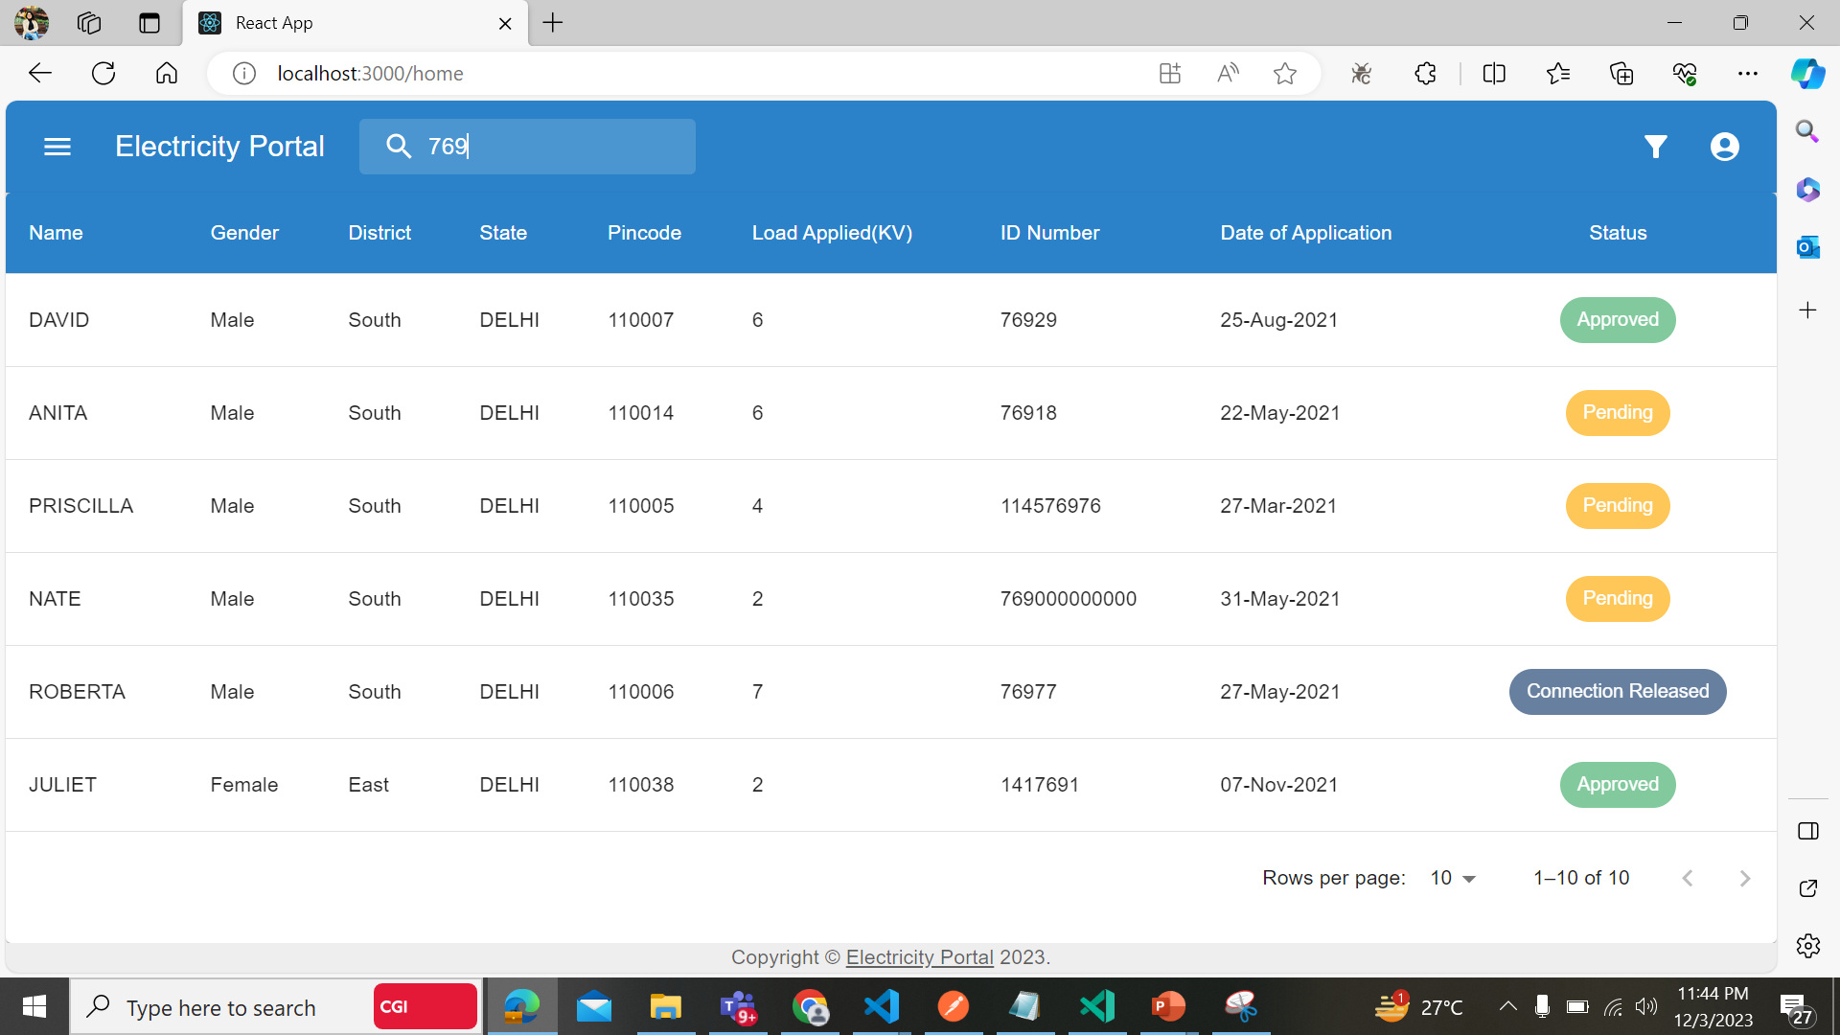
SEARCH FUNCTIONALITY
MARKET GAP

Slide 8
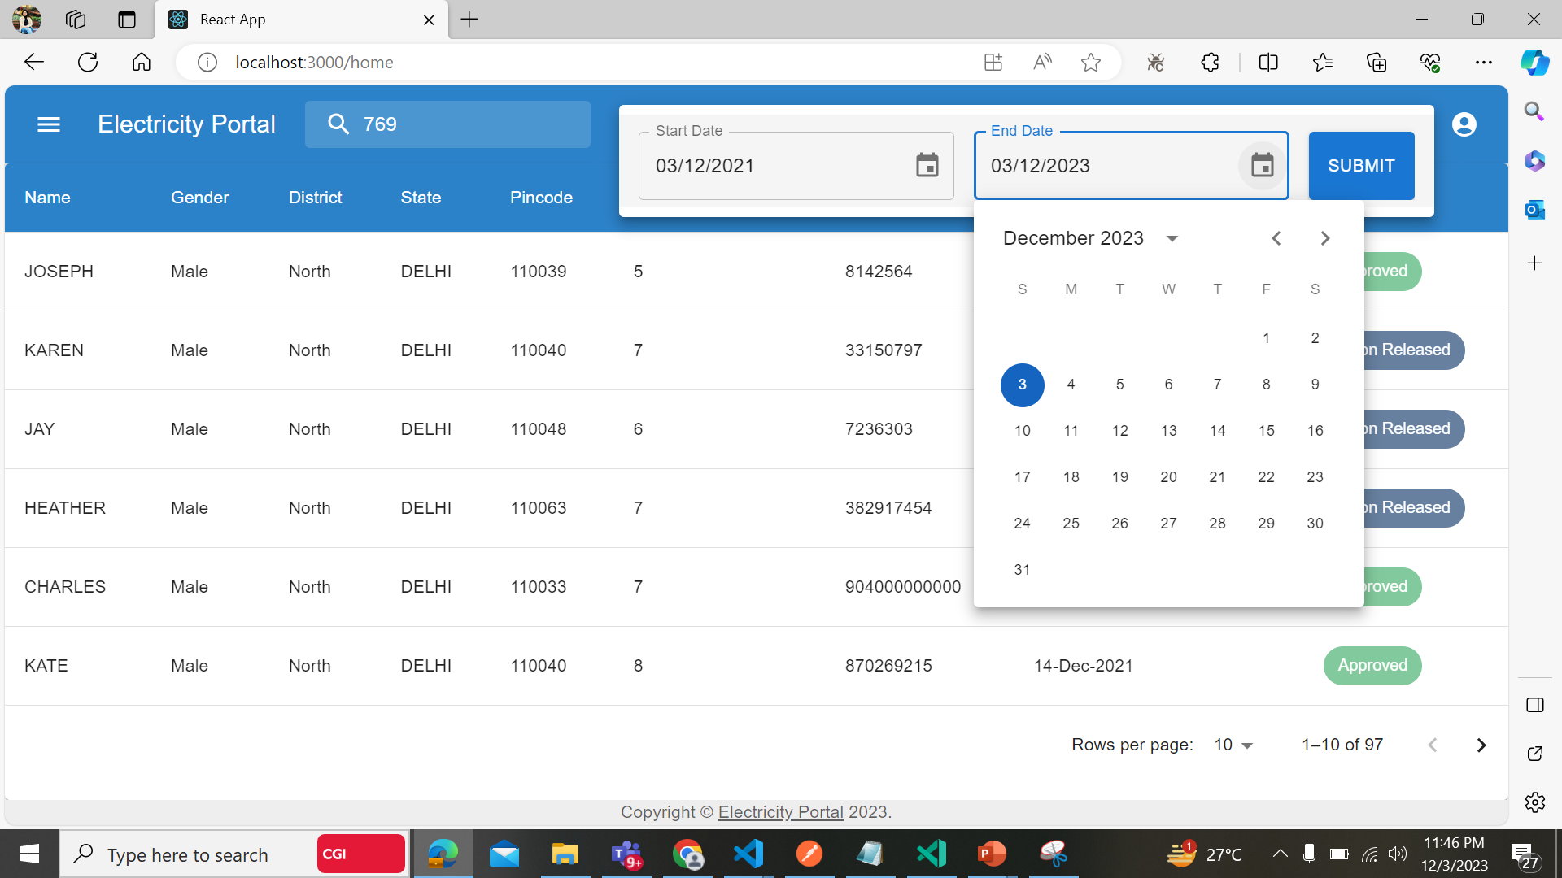
FILTER CONNECTIONS ON A DATE FILTER
MARKET GAP

Slide 9
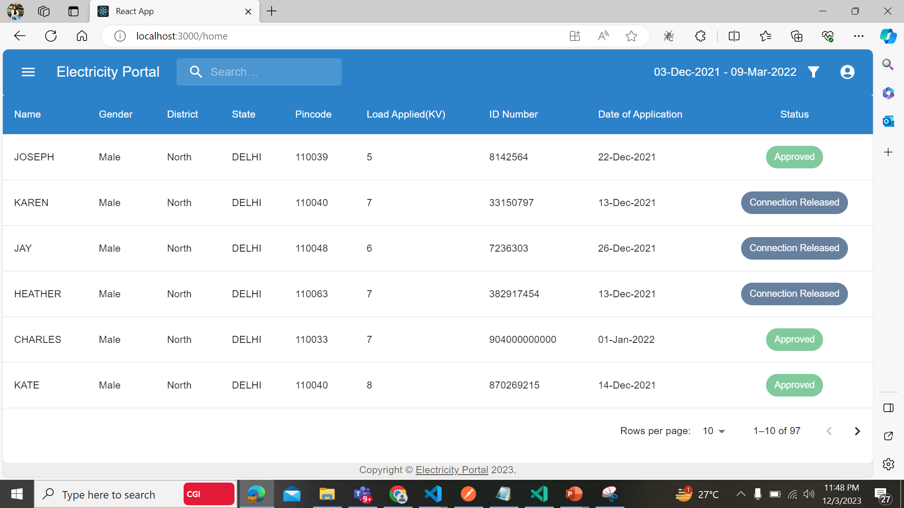
FILTERED DATE WISE CONECTIONS
MARKET GAP

Slide 10
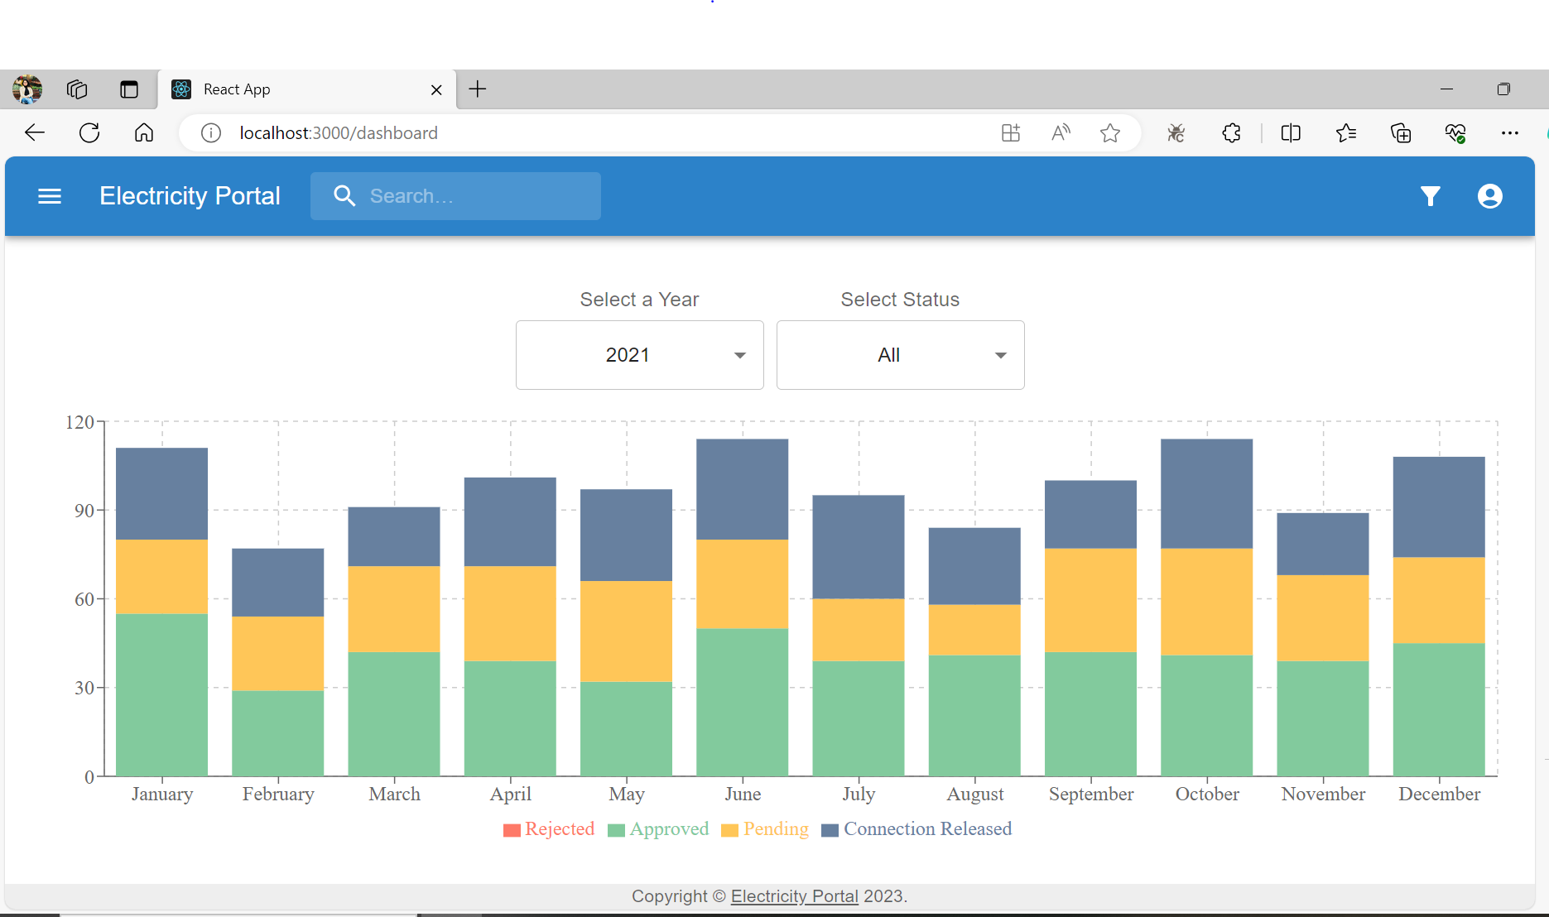
MONTH WISE CONNECTIONS CHART
MARKET GAP

Slide 11
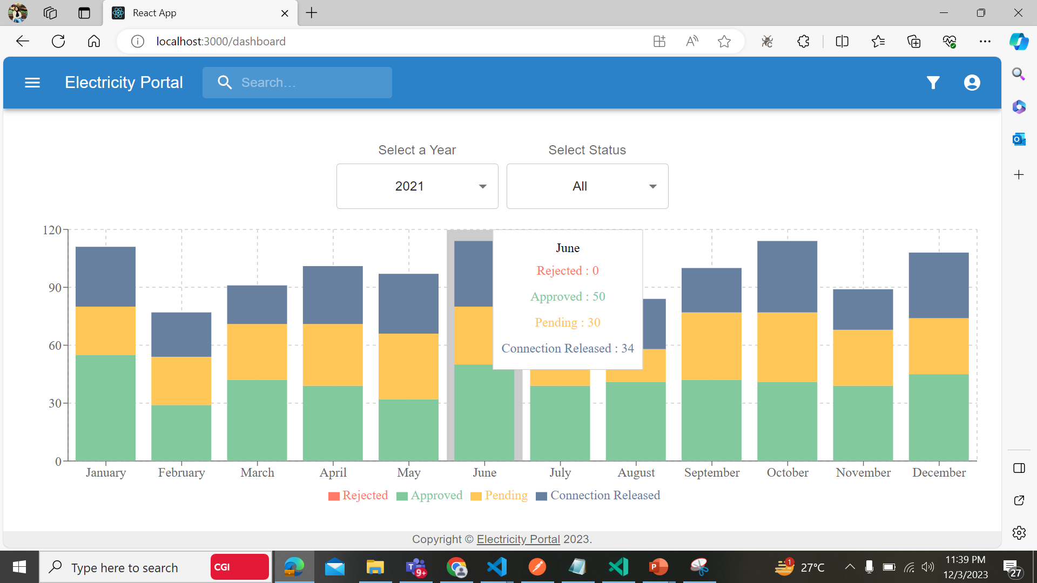
DATE FILTER FOR BAR CHART
MARKET GAP

Slide 12
THANK YOU…

